Slide 1
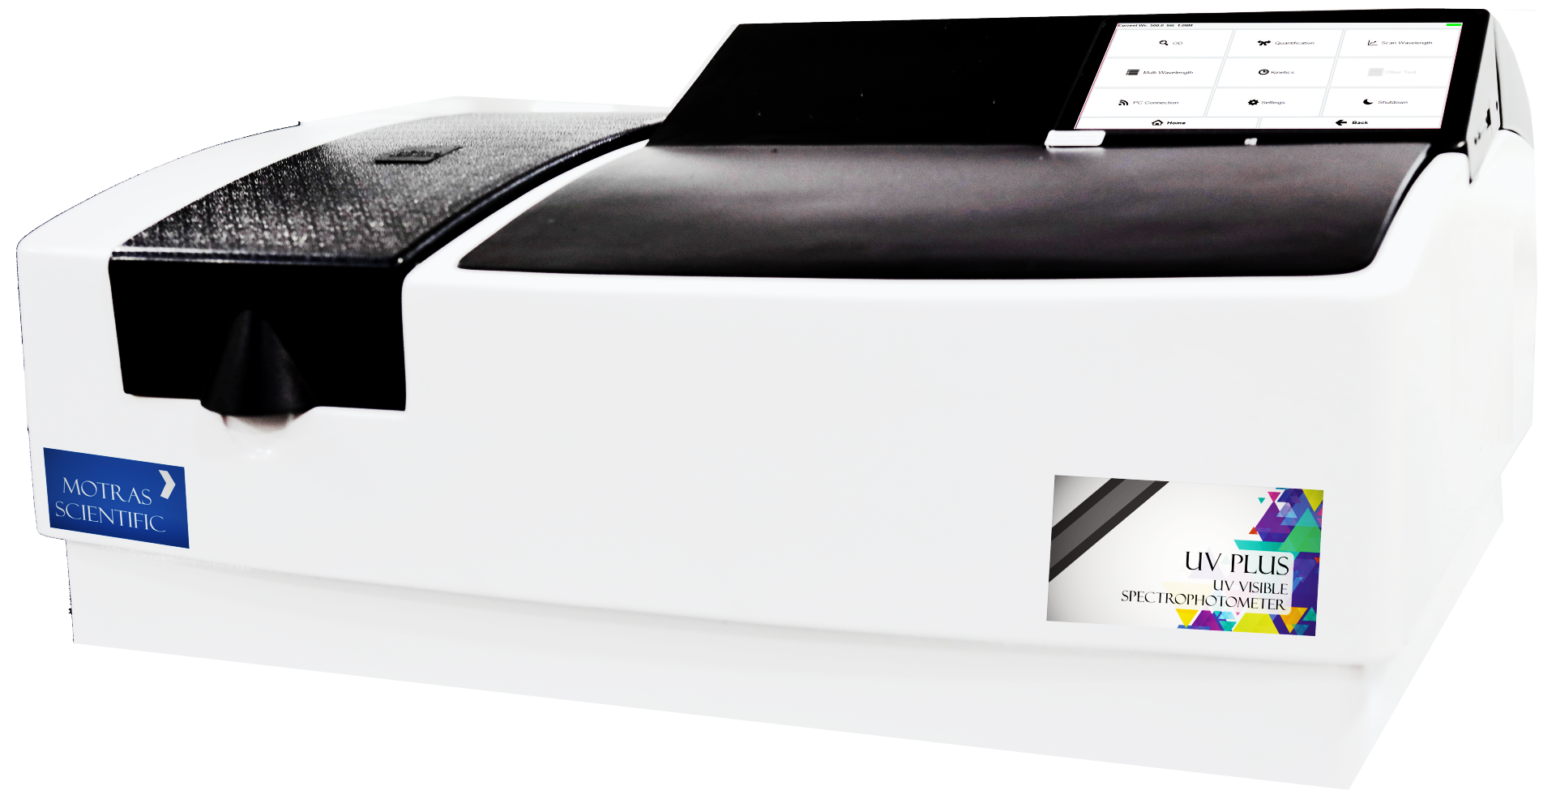
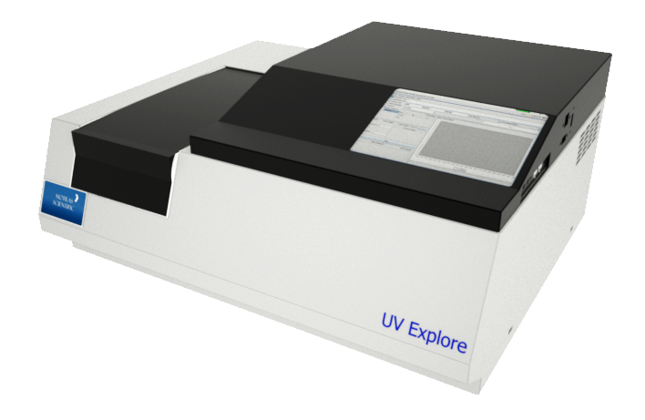
UV Plus
Designed and Manufactured in India
Motras Scientific Instruments PVT. LTD.

Slide 2
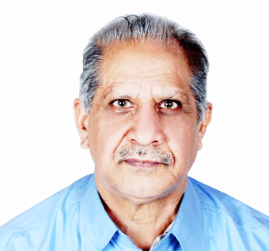
About Motras Scientific
We are pleased to inform you that MOTRAS Scientific Instruments Pvt. Ltd. a –Startup initiative , MSME registered with NSIC is developing new generation sophisticated analytical instruments and analysis software.
We have over 40 years of experience in spectroscopy and our team is led by Mr. K.C. Purohit who has been associated with Beckman, Varian, Instrumentation Laboratory, Bosh & Lomb, Jobin Yvon. These organisations were the planting seeds of spectroscopy as we know today.
We understand the environment, electrical setup available and hence have incorporated several techniques to eliminate the failure rate due to such trivial causes.
Our instrument uses imported Grating (sourced from Newport USA), detector (Hamamatsu Japan) and deuterium lamp (from Photron Australia); thus provides best available core component benefits.
Our instruments are deployed within the best-of-the-best institutes such as N.P.L., I.I.T., I.C.A.R., F.D.A., G.S.D.A., Pharmacopeia labs, NABL accredited labs, etc.

Slide 3
Quick overview of our software
Our software are CFR compliant with capability to load tests from our online servers.
The Instrument can be connected remotely to provide quick resolution to the end customer, demonstration, find out the failed part to enable quick resolution of breakdown
With complete in-house development of software, we are able to cater the requirements of our customer as per their needs
The software is compatible with Ethernet, WiFi, Bluetooth and USB interface
Free updates are available to user to enable best user experience over the course of Instrument’s life
With built in Windows 10 based PC, the need of external system is eliminated; thus saving cost and providing more value to the customer

Slide 4
Quick overview of our hardware
With in-house development of hardware design, PCB, and other processes ensures the best, reliable product to our customers
We are able to quickly adapt to our customer’s feedback
Our instruments are designed with Indian conditions in mind; from rodent proof design to custom switch mode power supplies with working range from 100v to 300v
We understand the absence of ground/earth connection at customer location and have procedures to mitigate such trivial issues

Slide 5
Applications
Detection of Impurities
UV absorption spectroscopy is one of the best methods for determination of impurities in organic molecules.
Structure elucidation of organic compounds
UV spectroscopy is useful in the structure elucidation of organic molecules, the presence or absence of unsaturation, the presence of hetero atoms.
Quantitative analysis
UV absorption spectroscopy can be used for the quantitative determination of compounds that absorb UV radiation. This determination is based on Beer’s law
Additional peaks can be observed due to impurities in the sample and it can be compared with that of standard raw material
Molecular weight determination
Molecular weights of compounds can be measured by preparing the suitable derivatives of these compounds.

Slide 6
Spectrophotometer applications
Spectrophotometers are used across a wide range of industries for versatile applications. Here is a brief summary of it’s applications
Impurity detection
Quantitative analysis
UV absorption spectroscopy is one of the best methods for determination of impurities in organic molecules.
Additional peaks can be observed due to impurities in the sample and it can be compared with that of standard raw material
UV absorption spectroscopy can be used for the quantitative determination of compounds that absorb UV radiation. This determination is based on Beer’s law
Medical
Bioscience
Defense
Pharmaceuticals
Structure elucidation of organic compounds
Molecular weight determination
Forensics
Molecular weights of compounds can be measured by preparing the suitable derivatives of these compounds
UV spectroscopy is useful in the structure elucidation of organic molecules, the presence or absence of unsaturation, the presence of hetero atoms.
Food & Agriculture

Slide 7
Didymium filter test
E 125 Filter test results
 | Shimadzu UV 2450 | Motras UV Plus | Certified value
270nm | 1.619 | 1.611 | 1.613
280 nm | 1.469 | 1.464 | 1.465
300 nm | 1.325 | 1.319 | 1.316
320 nm | 0.850 | 0.847 | 0.857
340 nm | 0.611 | 0.608 | 0.617

Slide 8
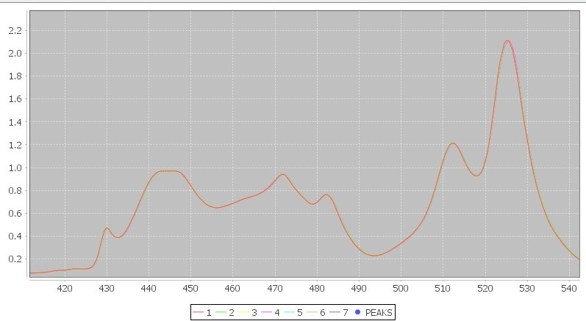
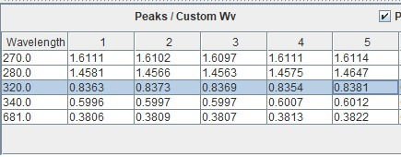
Extreme Stable results with use of anti-drift technology!
In this image, 7 scans of same sample is shown.
Each scan is done after 1 hour interval which shows extreme stable results with zero drift
Tabular format shows that the stability of instrument is very high
Drift in 3rd/4th place decimal is seen during 7 hours of usage
7 scan overlay which shows the stability and repeatability of instrument!

Slide 9
Our Advantage
Made in India, for India
Best yet cost effective electronics and latest technology in use
Self developed electronics and software
Vision to implement the latest technology to surpass the current market standard
Over 40 years of experience in domain
Flexibility to enhance product to cater specific needs

Slide 10
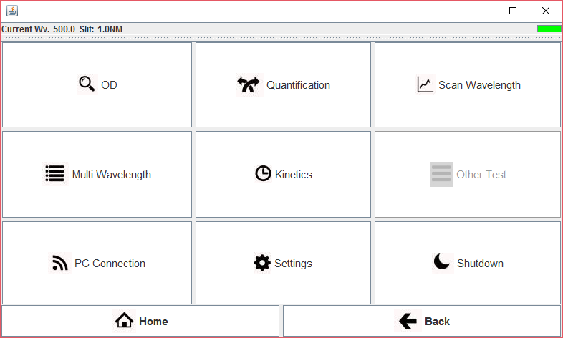
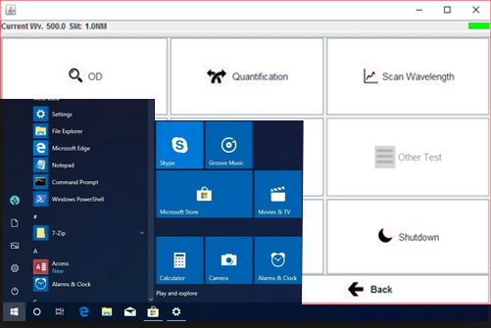
Touch screen interface
The home screen is designed as simple and elegant which allows user to easily navigate through options without the need to read extensive manuals
Easy to use icons with built in Windows 10 for superior productivity!

Slide 11
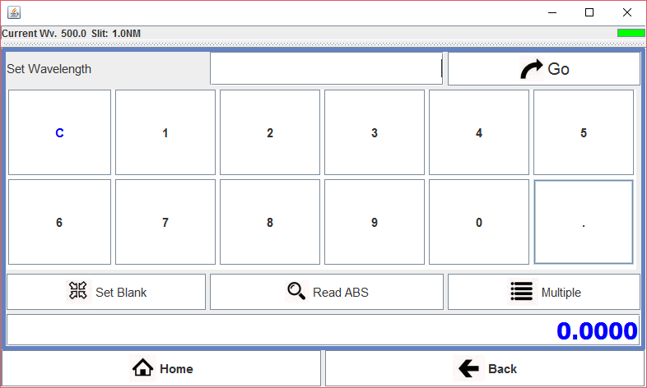
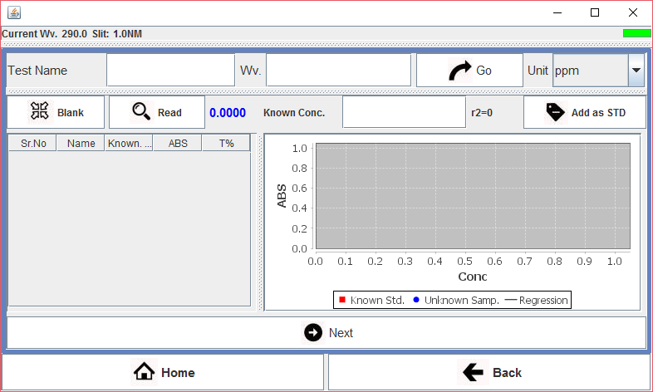
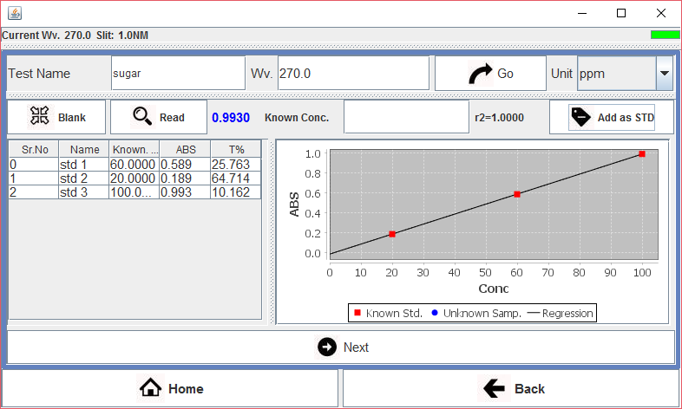
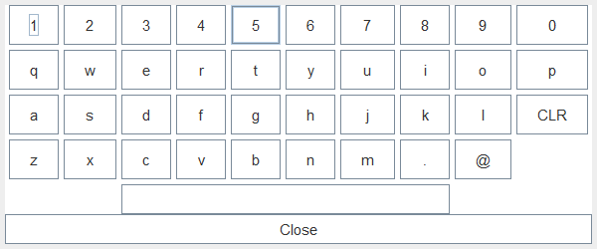
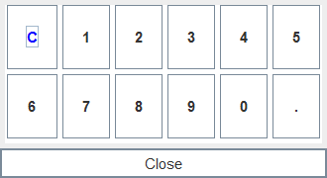
Quantification mode using the standalone screen
Easy to use keyboard with big icons for easy input of data

Slide 12
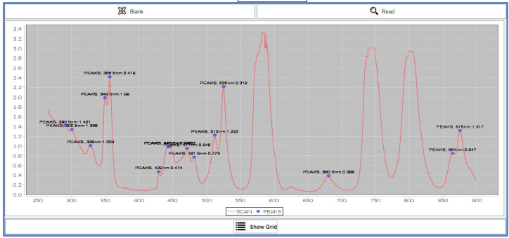
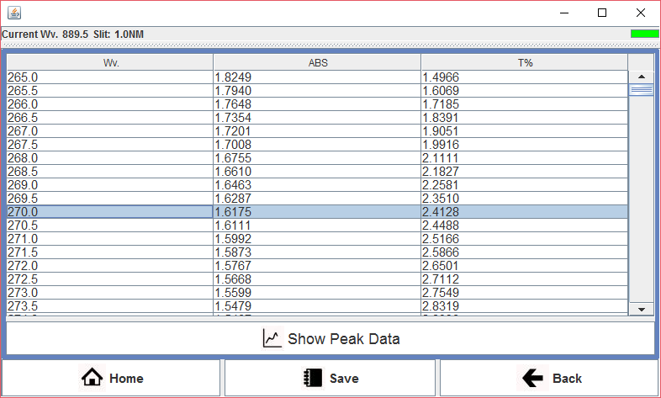
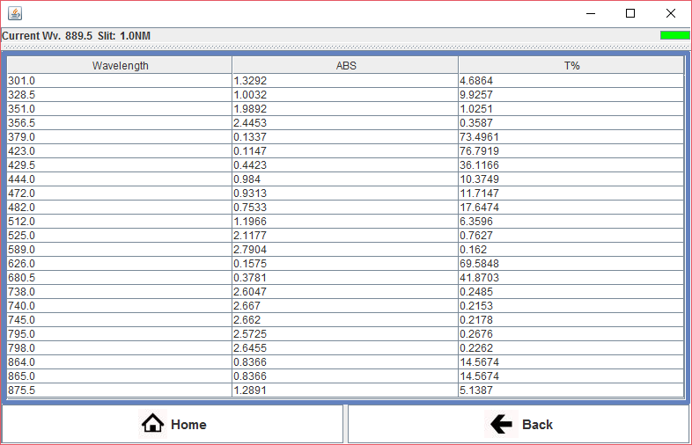
Scanning with graph, peaks, and data table for
Easy and quick analysis

Slide 13
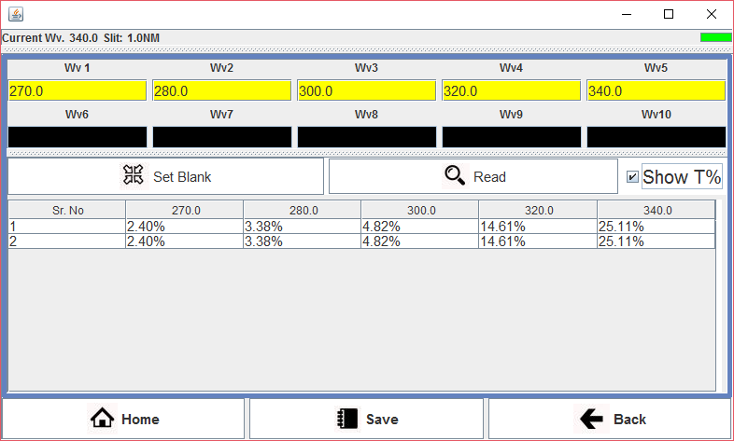
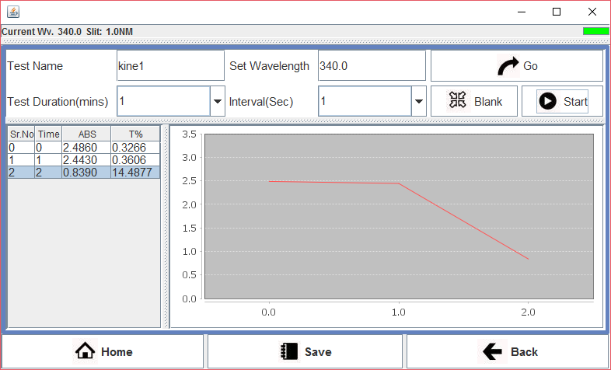
Kinetics Mode with linearity determination
within readings
Multi wavelength mode for discreet wavelengths

Slide 14
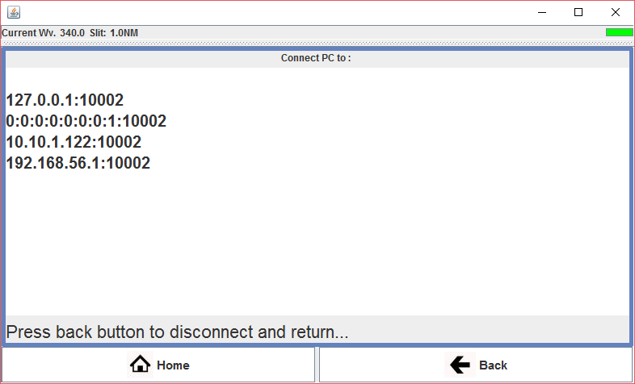
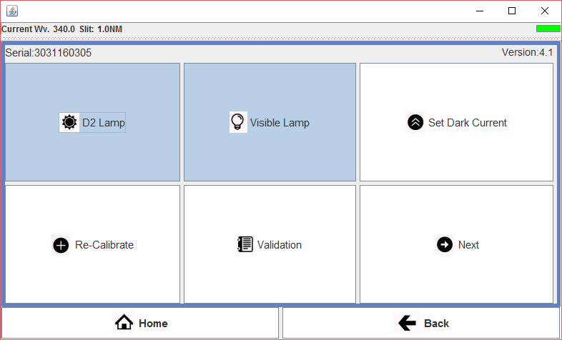
Network based PC Connection
This allows users to access the instrument within
Same network or via Internet with configuration
Simple instrument management

Slide 15
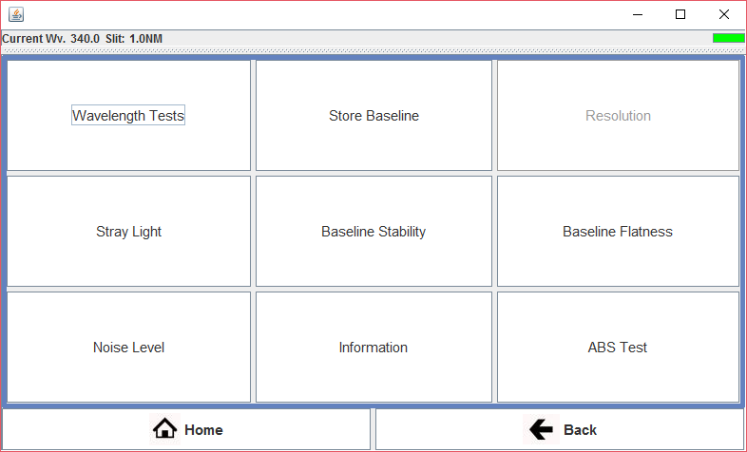
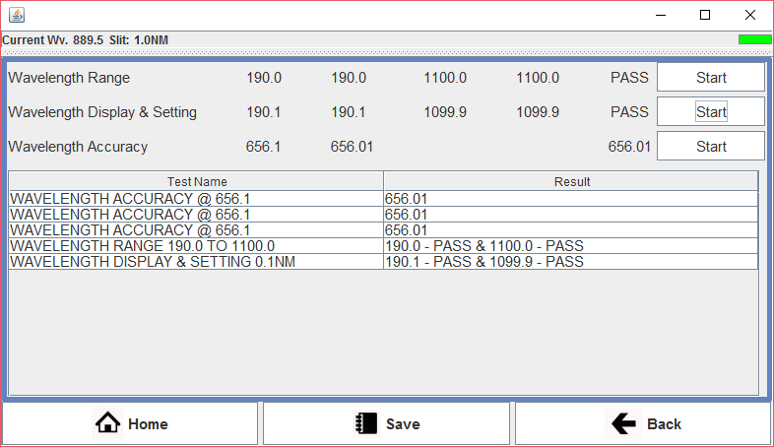
Built in I.P. tests for easy audit process
Stray light test includes KCL, NaI, NaNo2

Slide 16
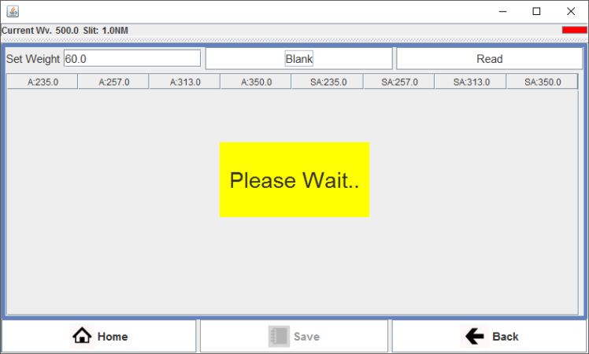
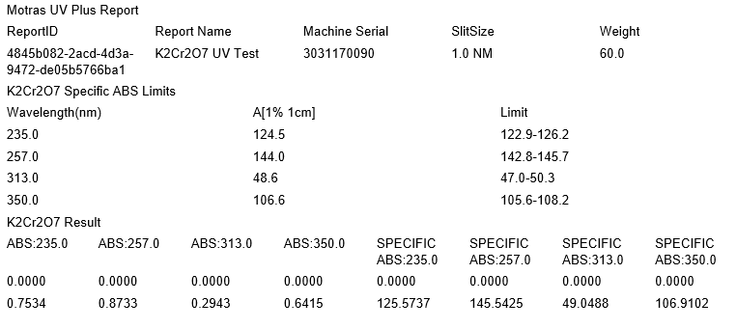
In built potassium dichromate test with easy to use interface
Test is run using “weight” and the instrument calculates the specific absorption automatically!
Report generated with accepted values and obtained value for easy and quick determination

Slide 17
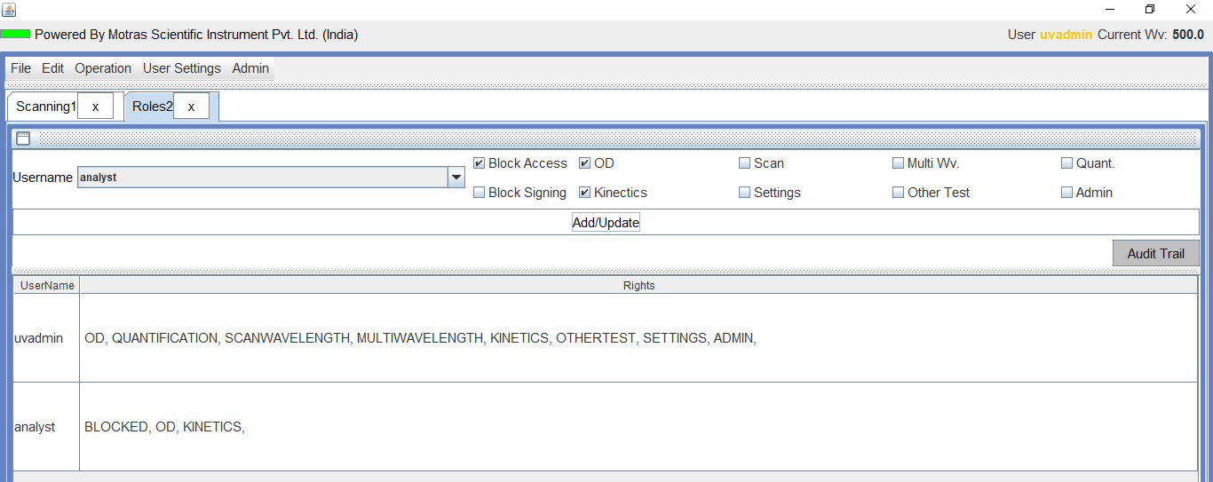
Extensive user management with roles and access features settings
System keeps track of all events and actions using built in database. These actions can be seen using the Audit Trial window

Slide 18
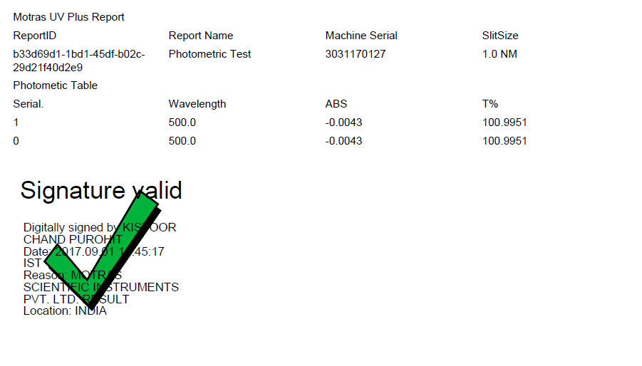
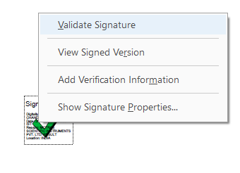
Automatic validation
And detection of changes
Post signing
Digitally Signed results!

Slide 19
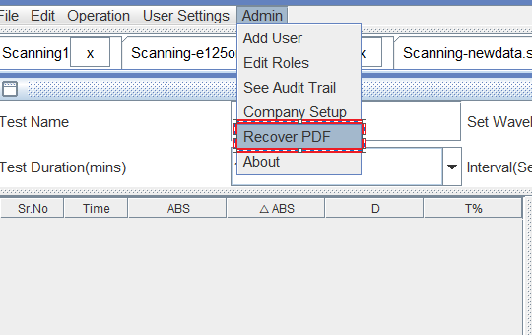
The system automatically keeps a backup of all saved and printed PDF within its internal database. Using the recover pdf, an admin can recover PDF in case of data loss or to check the integrity of the results

Slide 20
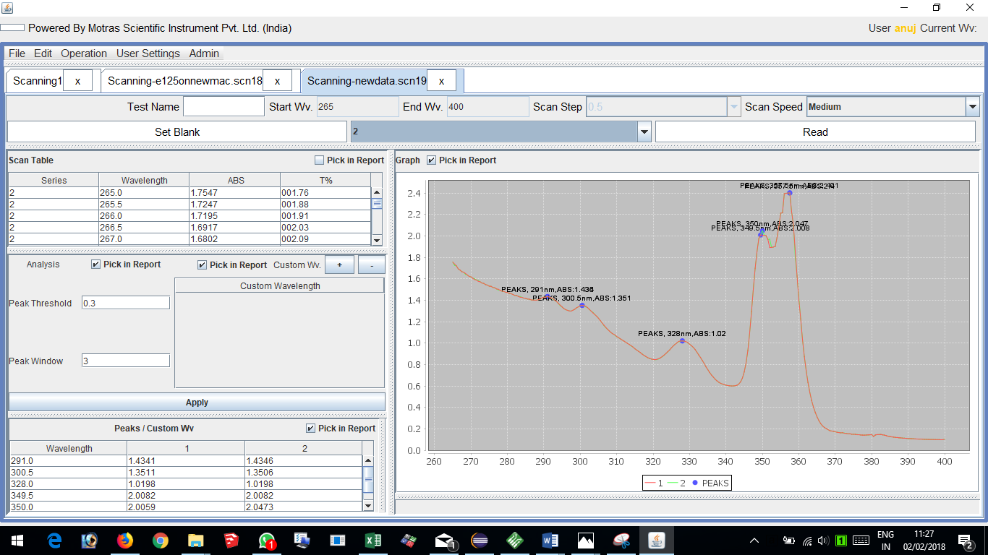
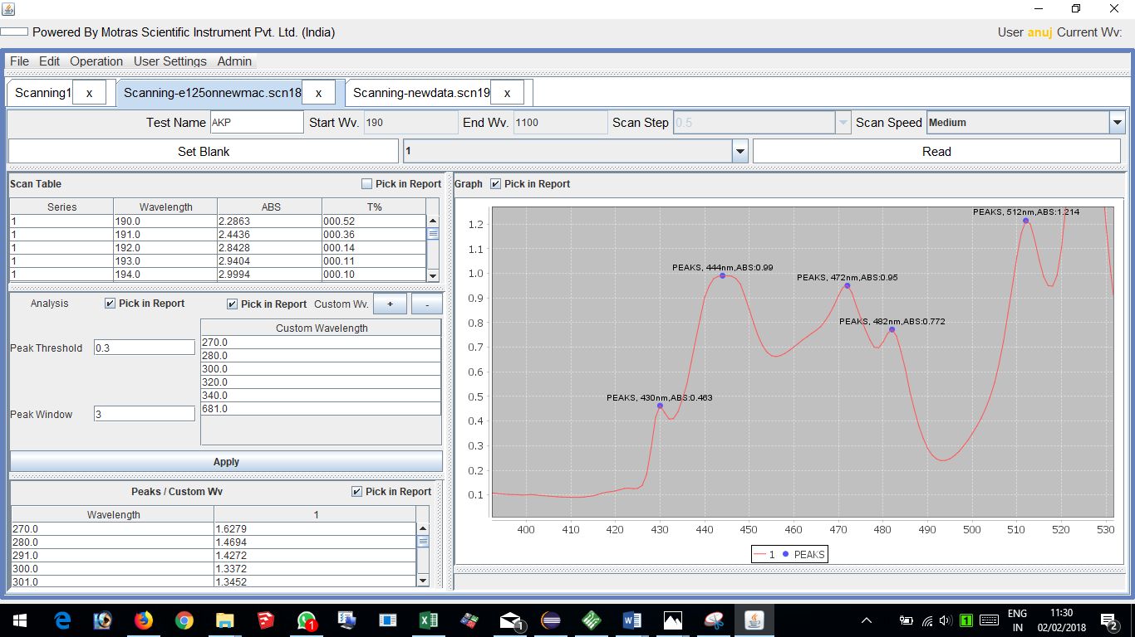
Powerful desktop software
Easy one click Zoom feature

Slide 21
Thank you
For more information please contact:
K C Purohit
CEO
Motras Scientific Instruments Private Limited
EA – 146, Inderpuri
Mobile: +91.9810018049
Email: kcpurohit@motras.in

