Slide 1
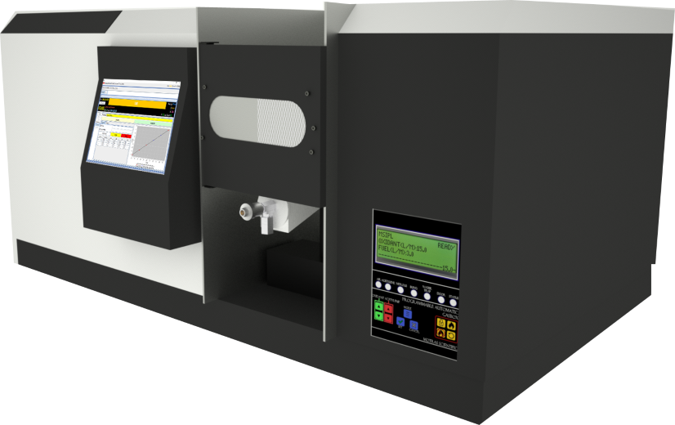
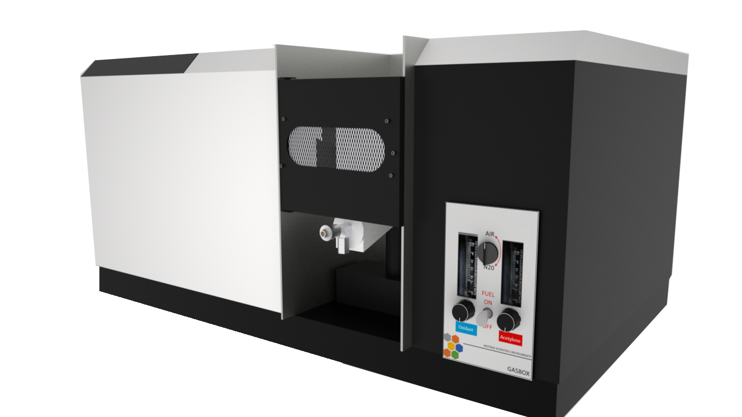
AAS Plus
Designed and Manufactured in India
Motras Scientific Instruments PVT. LTD.

Slide 2
About Motras Scientific
We are pleased to inform you that MOTRAS Scientific Instruments Pvt. Ltd. a –Startup initiative , MSME registered with NSIC is developing new generation sophisticated analytical instruments and analysis software.
We have over 40 years of experience in spectroscopy and our team is led by Mr. K.C. Purohit who has been associated with Beckman, Varian, Instrumentation Laboratory, Bosh & Lomb, Jobin Yvon. These organisations were the planting seeds of spectroscopy as we know today.
We understand the environment, electrical setup available and hence have incorporated several techniques to eliminate the failure rate due to such trivial causes.
Our instrument uses imported Grating (sourced from Newport USA), detector (Hamamatsu Japan) and deuterium lamp (from Photron Australia); thus provides best available core component benefits.
Our instruments are deployed within the best-of-the-best institutes such as N.P.L.,B.H.E.L, I.I.T., I.C.A.R., F.D.A., G.S.D.A., Pharmacopeia labs, NABL accredited labs, etc.

Slide 3
Quick overview of our software
Our software are CFR compliant with capability to load tests from our online servers.
The Instrument can be connected remotely to provide quick resolution to the end customer, demonstration, find out the failed part to enable quick resolution of breakdown
With complete in-house development of software, we are able to cater the requirements of our customer as per their needs
The software is compatible with Ethernet, WiFi, Bluetooth and USB interface
Free updates are available to user to enable best user experience over the course of Instrument’s life
With optional built in Windows 10 based PC, the need of external system is eliminated; thus saving cost and providing more value to the customer

Slide 4
Quick overview of our hardware
With in-house development of hardware design, PCB, and other processes ensures the best, reliable product to our customers
We are able to quickly adapt to our customer’s feedback
Our instruments are designed with Indian conditions in mind; from rodent proof design to custom switch mode power supplies with working range from 100v to 300v
We understand the absence of ground/earth connection at customer location and have procedures to mitigate such trivial issues

Slide 5
Our Advantage
Made in India, for India
Best yet cost effective electronics and latest technology in use
Self developed electronics and software
Vision to implement the latest technology to surpass the current market standard
Over 40 years of experience in domain
Flexibility to enhance product to cater specific needs

Slide 6
Features – Optical and Electromechanical
Up to 1024 Hz modulation for flicker free operation and increased stability
Real-time double beam energy display
8 independent channel HCL lamp power supply
Automatic lamp positioning
Lamp energy optimization
Peak detection and optimization
Automatic possible interference detection and warning
Automatic detection of “Blank” contamination
Automatic EHT selection

Slide 7
1024 Hz modulation base clock
Base modulation clock at 1024 hertz
Adjustable modulation to ensure future upgradability
Enables high speed signal capture with up to 3.3 ABS
HCL lamps and Deuterium lamp dead time delay to ensure zero cross contamination
Accurate lamp current monitoring using high resolution controller
Dark signal correction in single beam and double beam modes

Slide 8
Real-time Double Beam energy display
Single screen section to display all parameters of the instrument enables user to see the complete configuration of the instrument easily
RSD, R-square, Mean ABS, replicates, raw energy display
Lamp selection, current wavelength, slit configuration, EHT

Slide 9
Programmable 8 channel independent HCL supply
Independent power supply for all 8 HCL lamps
Lamp current configuration
Default HCL wavelength/line selection
Default spectral bandwidth selection
Multi-active features allows more than 1 Lamp to be active allowing warmup
Auto active/inactive for lamp life conservation

Slide 10
Automatic lamp positioning and optimization
The instrument moves the turret to find the position of maximum energy
This results into one time alignment of lamps (optimized)
The lamp energy is automatically set for the optimal analysis
High performance PMT enables high SNR ratio
Automatic burner (optional) is set for best sensitivity
These features allows the instrument to reproduce results

Slide 11
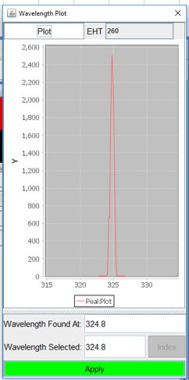
Peak detection and optimization
Instrument finds the peaks and adjusts the parameters
Automatic selection of desired peak even if more than one peaks are found
Warning to display possible interferences which warns the user to take action

Slide 12
Parameters setup for analysis
Parameter | Option | Action
Signal Mode | Absorption | System is operated in Absorption Mode
 | Emission | System is operated in Emission Mode
Technique | Single Beam | System is operated in Single Beam mode
 | Double Beam | System is operated in double beam mode with increased stability
Background Correction | On | D2 background correction is enabled
 | Off | D2 background correction is disabled
Integration Time | [1..10] | Integration time for each replicate
Replicates | [2..8] | Number of replicated to be processed before computing averaged ABS
Read Delay | [1..10] | Delay to be performed after sample read button is pressed
Test Unit | PPM, PPB, mg/L,ug/L | Test unit to be printed on the report

Slide 13
Features – Automatic Gas box
Real-time nebulizer flow display
Real-time sensors to interlock and shutdown
Nebulizer choking detection
Nebulizer pressure loss sensor
Real-time flame monitoring
Real-time mains power monitoring
Safe start-up and shutdown of Nitrous Oxide – Acetylene flame

Slide 14
Programmable fully automatic gas box
Fully automatic gas box with software controlled fuel and oxidant flow
All safety interlocks built in with logic to react on real time event
Independent display to program gas box with provision to control via the software also
Real-time display of flow rate of nebulizer
Inbuilt bypass auxiliary oxidant line to compensate nebulizer flow rate in real time
Safe shutdown from all operating modes even in case of sudden power failure
Memory recall feature to set the fuel and oxidant mixture ratio as per optimal setting
Inbuilt 8-10 seconds backup for safe shutdown on power loss
The gas box has logical workflow from Idle -> Ignition mode -> ARM ->Ignite ->Extinguish -> DISARM - > Idle

Slide 15
User accessible errors and interlocks
Error codes displayed on LCD screen and as well as dedicated LED system
Industry leading safety features with sensors to detect nebulizer choking, nebulizer missing, flame disturbed, power loss and more
Detection of burner on the basis of oxidant
Digital water trap to ensure safe operation at all times

Slide 16
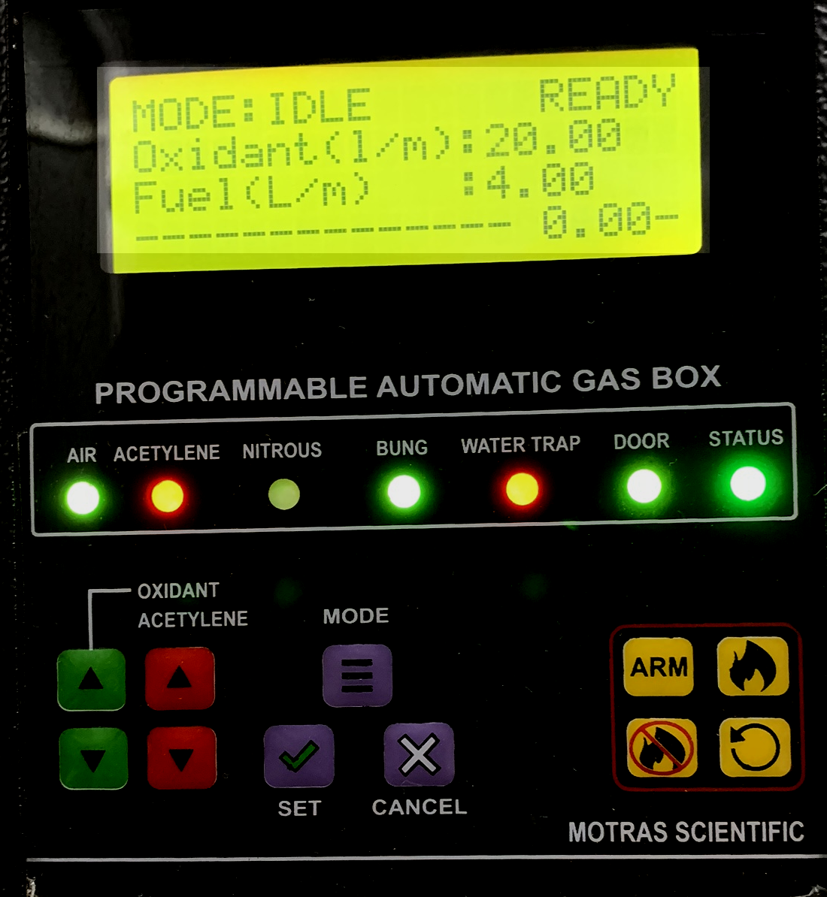
Example to show nebulizer error
The gas box mode is set to Idle
The nebulizer flow rate is shown as “0.00” as air is not released

Slide 17
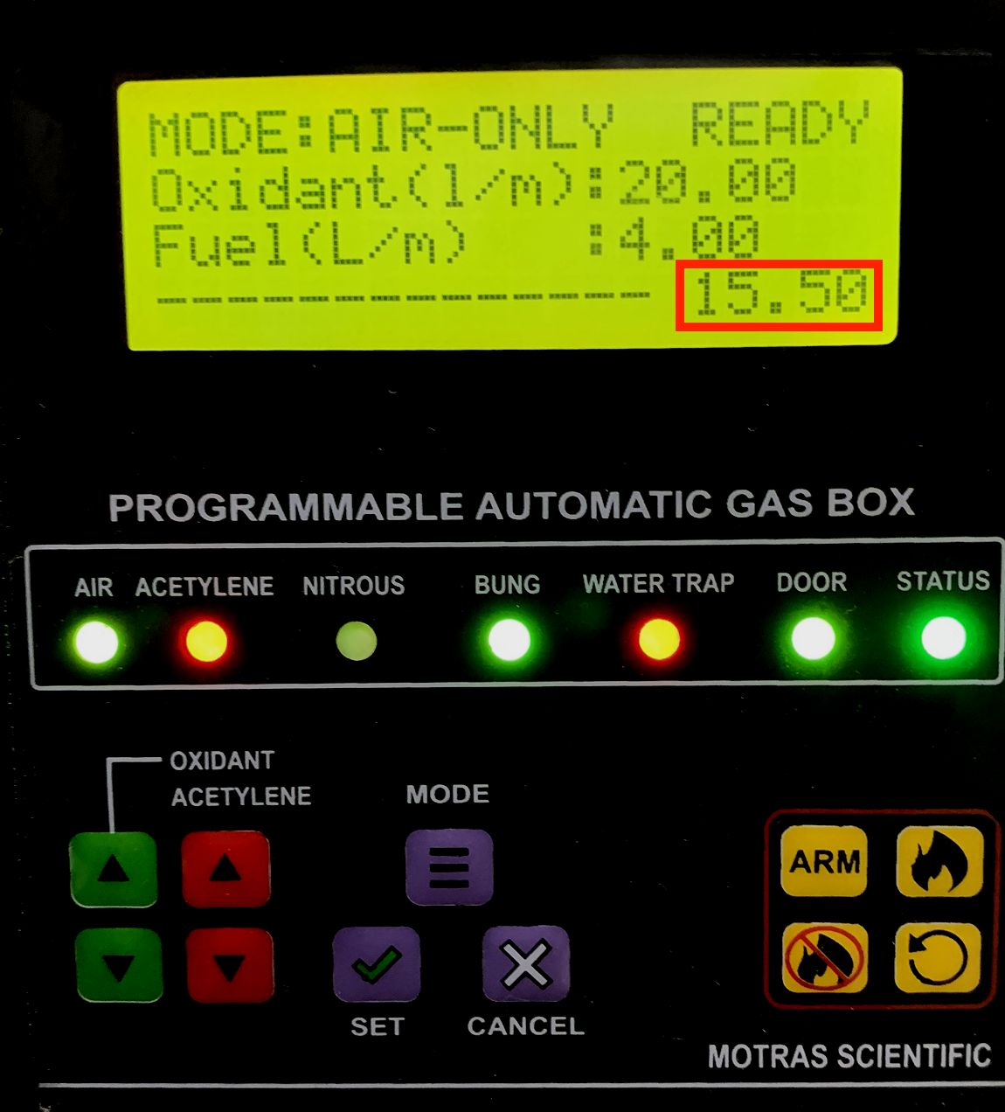
Example to show nebulizer error
The gas box mode is changed to AIR-ONLY
The nebulizer flow rate is shown as “15.50” as air released
This mode is used to check the atomisation and flow rate of nebulizer
If the nebulizer is clogged, then the flow rate should indicate the same to the user

Slide 18
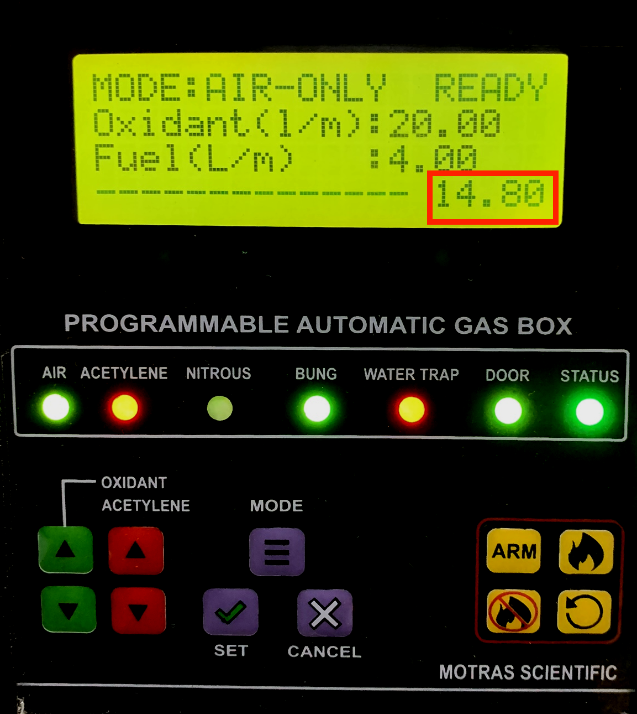
Example to show nebulizer error
Fine tuning the nebulizer show that the flow rate has now changed from “15.50” to “14.80”
This allows user to preciously set the flow rate to any previously known value
Results into extremely high repeatability as other instruments do not show the flow rate and the user has to “guess” the set value by the “feel” of the nebulizer fog

Slide 19
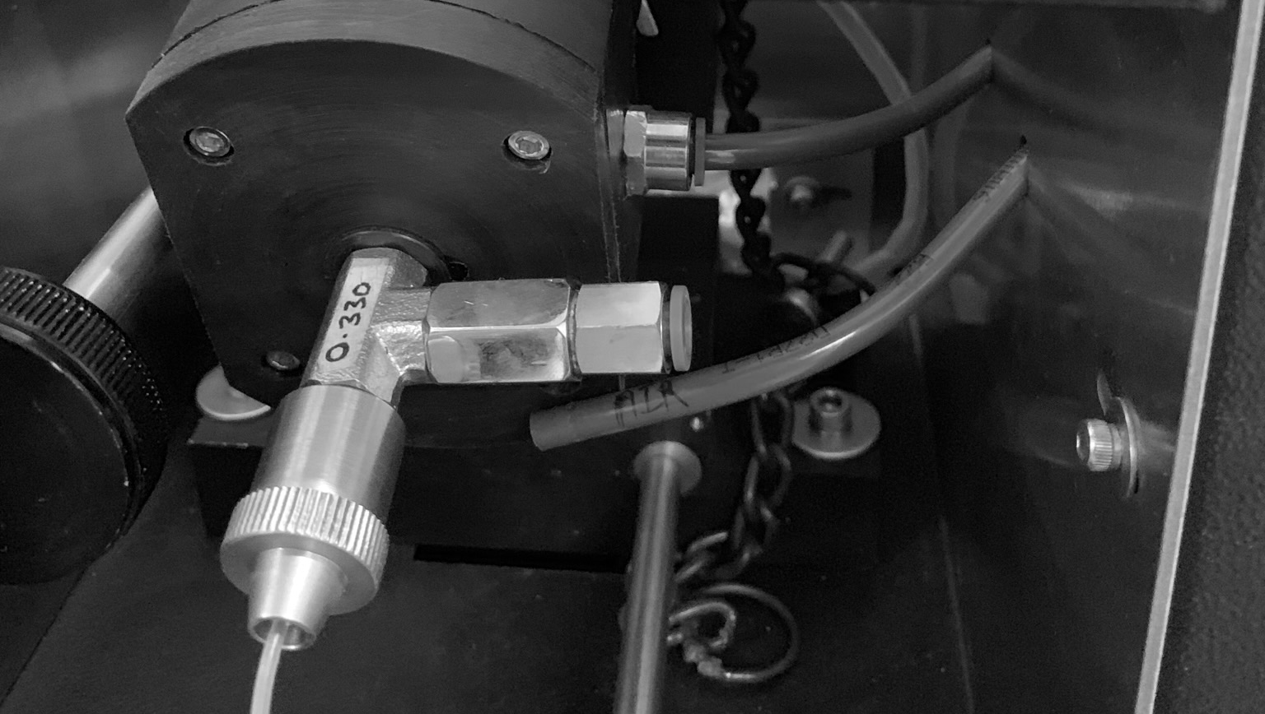
Example to show nebulizer error
The nebulizer is disconnected to simulate the error

Slide 20
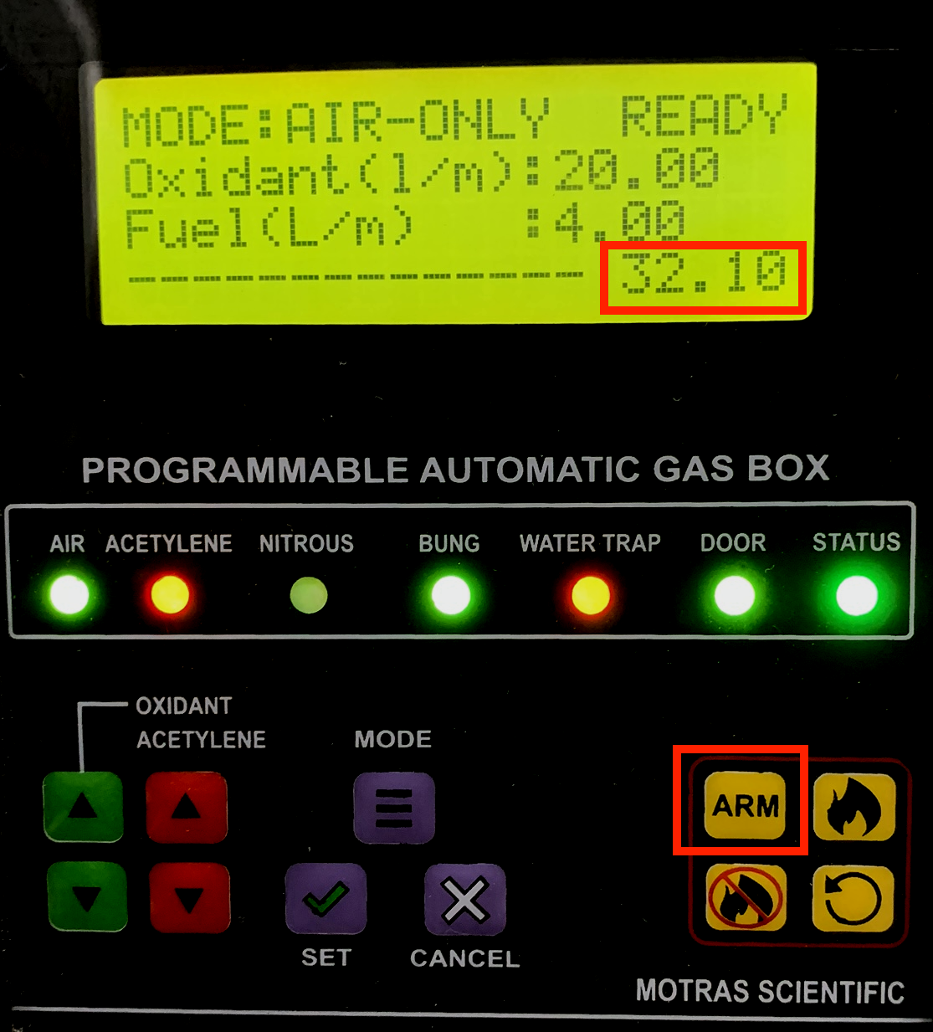
Example to show nebulizer error
Notice that the flow rate is now shown as 32.10
This is not a safe value for the gas box and the logic knows that the nebulizer is missing
The user tries to “ARM” the gas box

Slide 21
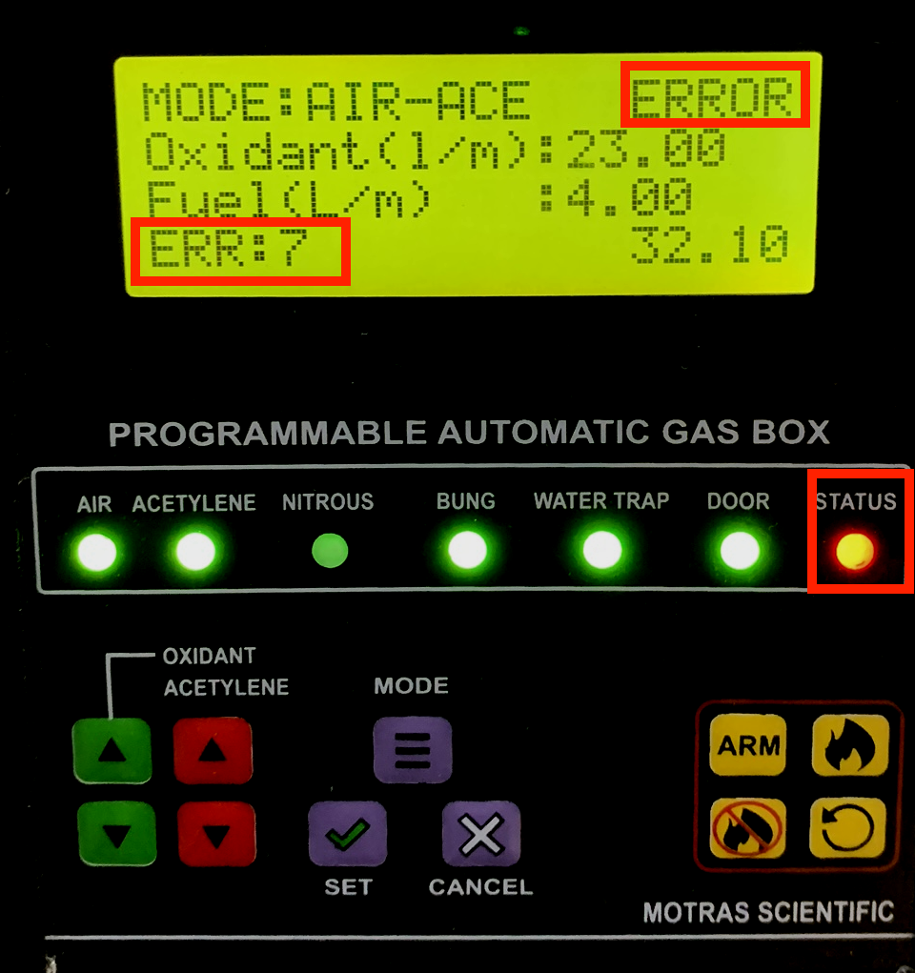
Example to show nebulizer error
Notice that the gas box reports ERROR
This is not a safe value for the gas box and the logic knows that the nebulizer is missing thus it does not allow the arming of gas box which is mandatory for ignition
The error number 7 is shown which is for the nebulizer error
The master status LED turns “RED”
Audible error tone is also heard by the user to gain attention

Slide 22
Example to show nebulizer error
Similar layout is also available in software mode

Slide 23
Features – Manual Gas box
Safe and sturdy operation
Calibrated flow meters
Mechanical display of fuel and oxidant flow rate
Single shot toggle of Air to Nitrous oxide
Locked burner and nebulizer
Safe bung assembly
Clear and large window to display fuel and oxidant flow rate

Slide 24
Report merge software
Software to merge results from various different batches
Software automatically created a group/pivot table for reporting
Warning is shown to the user if duplicate values are founds
Report can be exported as PDF, XLS, CSV, HTML, Text file, and many more formats
Reports can be stored to centralized database system allowing easy management and recalling

Slide 25
Auto sampler Programmer
Easy to use software to program the sampler
Ad-hoc access enables quick analysis
Up to 67 samples as default tray
More tray options with more number of samples
One touch tray loading and unloading feature
Self-alignment of tray to enable accurate and precise results
Sample shaker function
Auto email results when samples are finished

Slide 26
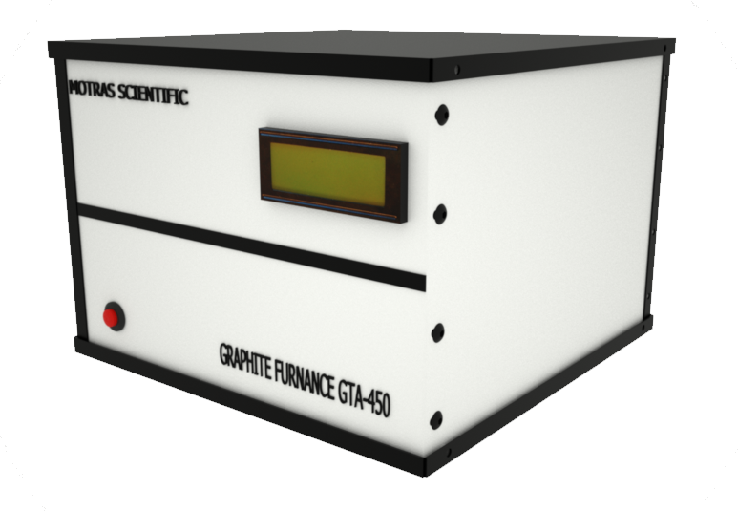
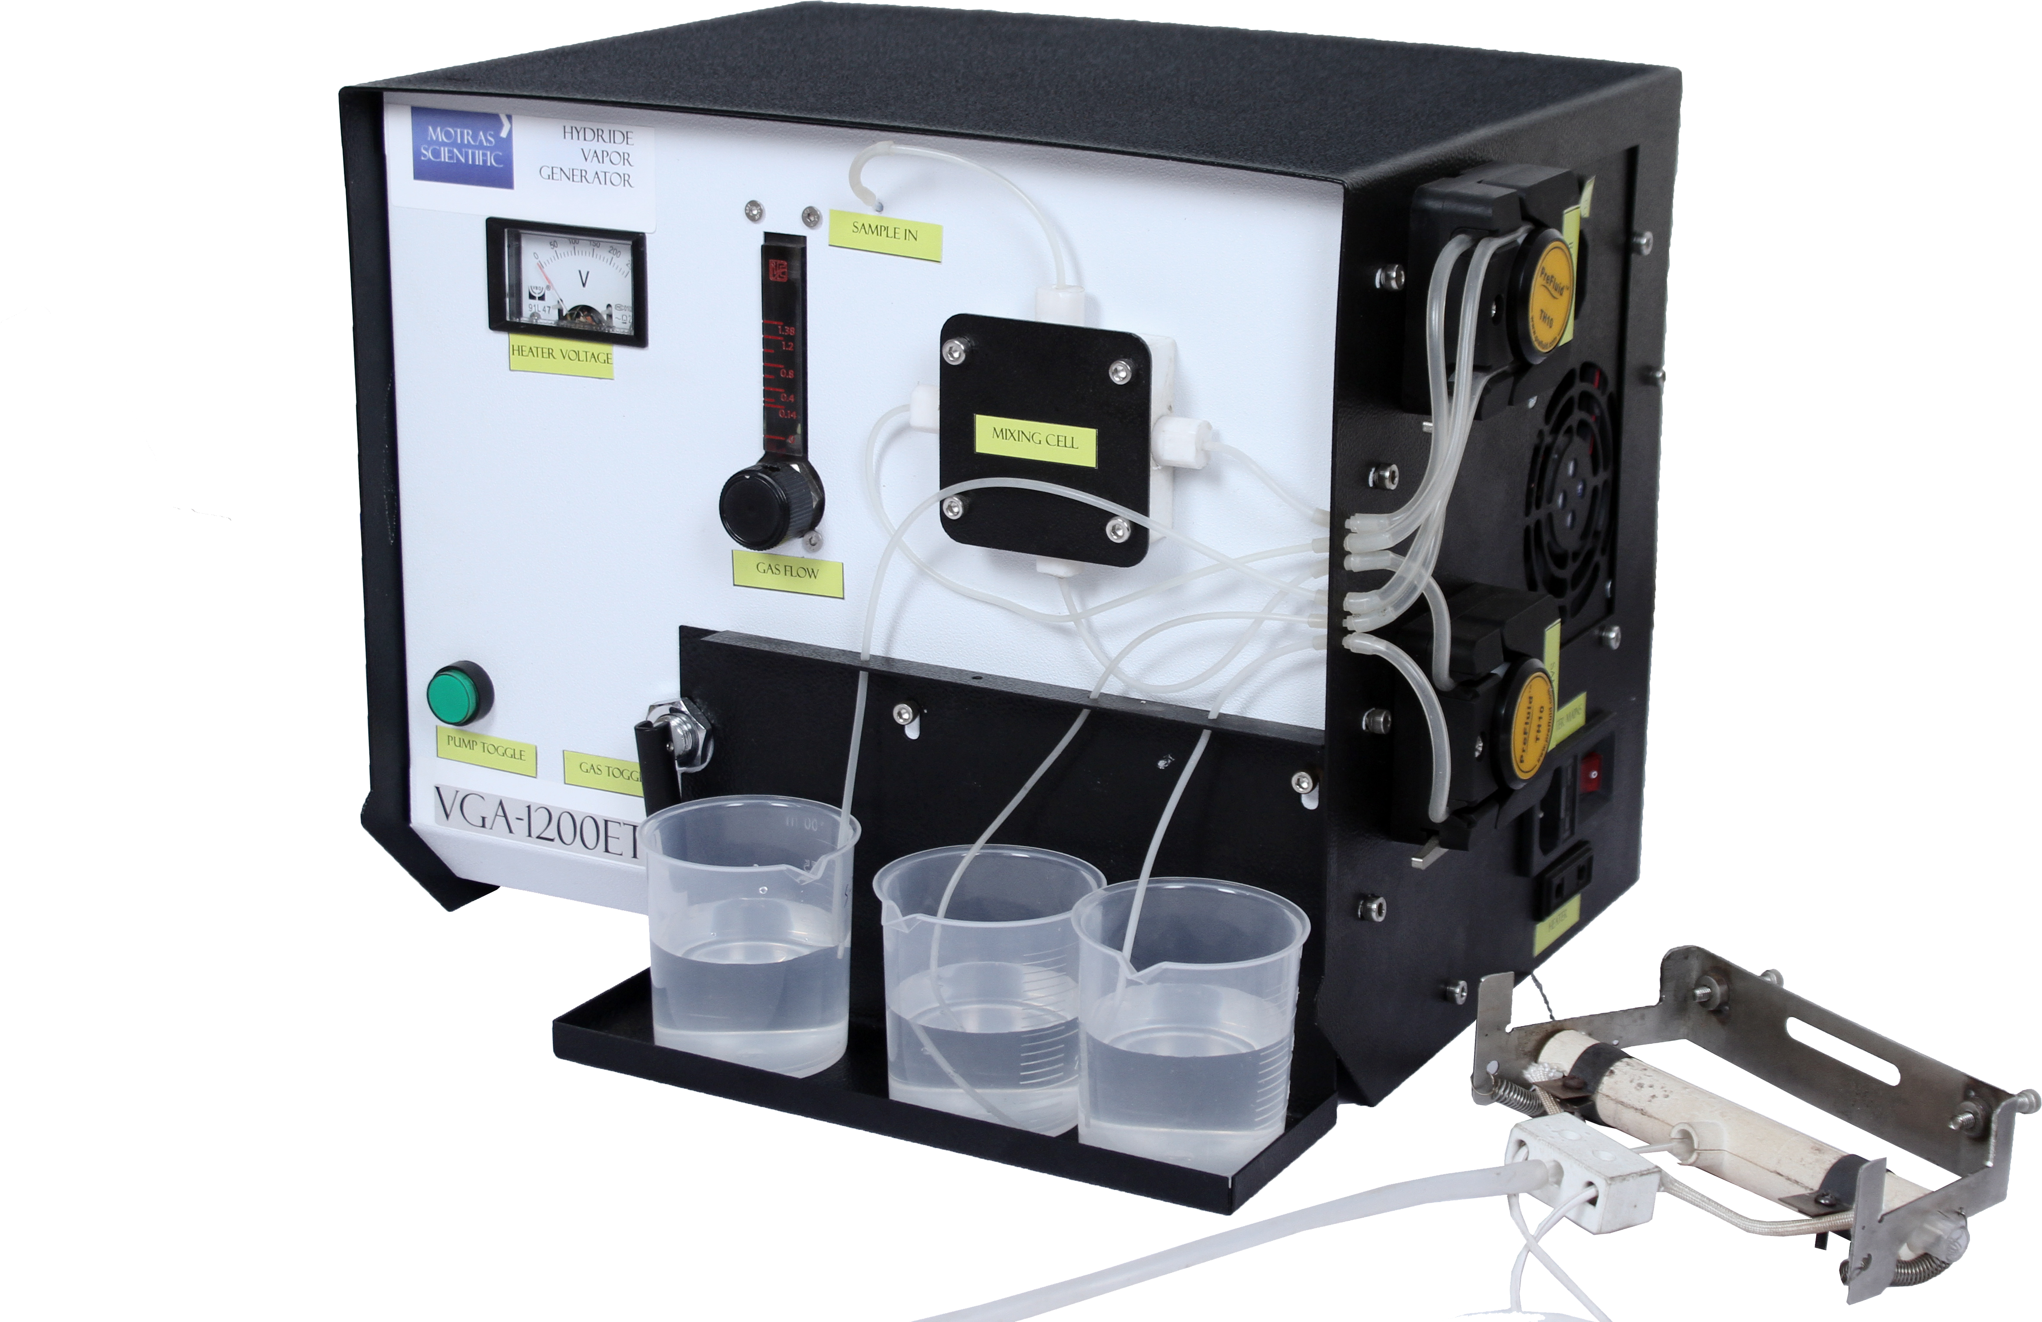
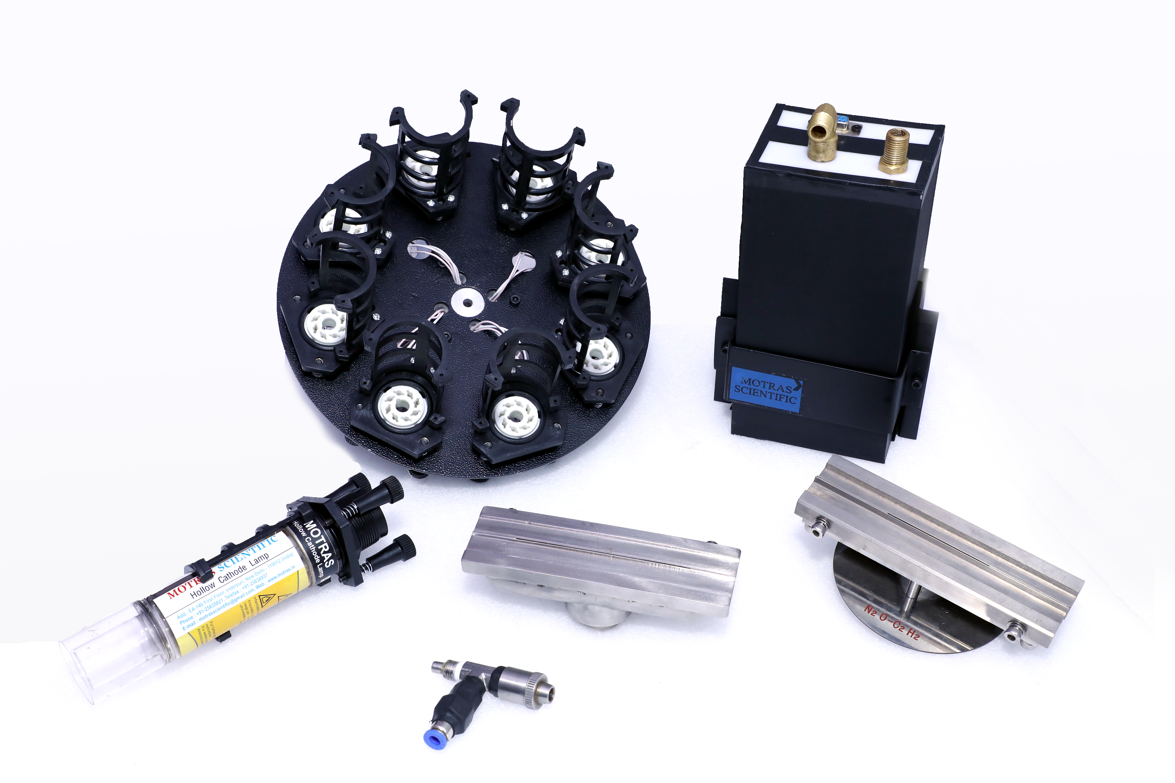
Accessories and supporting systems

Slide 27
Thank you
For more information please contact:
K C Purohit
CEO
Motras Scientific Instruments Private Limited
EA – 146, Inderpuri
Mobile: +91.9810018049
Email: kcpurohit@motras.in

